Slide 1
Combact Resistance
Stefania Stefani
Dept of Biomedical and Biotechnological Sciences
Consultant Policlinico University Hospital
School of Medicine UNICT

Slide 2
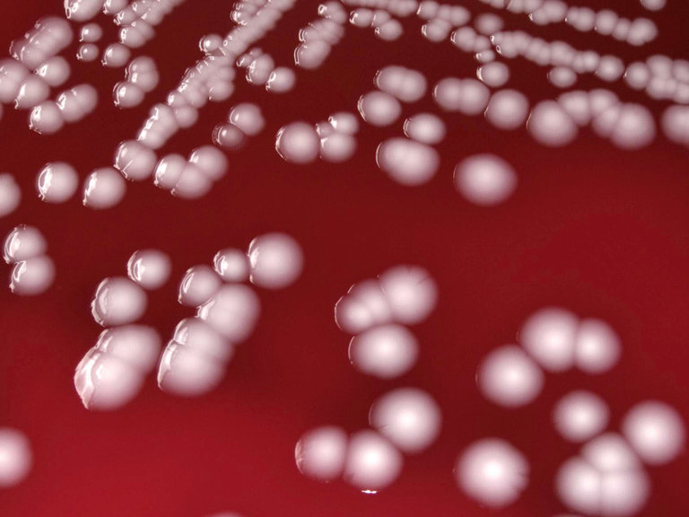
Geneve, February 27, 2017
“The World Health Organization (WHO) warned on Monday that a dozen antibiotic-resistant “superbugs” pose an enormous threat to human health, and urged hospital infection-control experts and pharmaceutical researchers to focus on fighting the most dangerous pathogens first.
The rate at which new strains of drug-resistant bacteria have emerged in recent years, prompted by overuse of antibiotics in humans and livestock, terrifies public health experts. Many consider the new strains just as dangerous as emerging viruses like Zika or Ebola”

Slide 3
The dirty one dozen
WHO priority pathogens list for R&D of new antibiotics
Priority 1: CRITICAL
Acinetobacter baumannii, carbapenem-resistant
Pseudomonas aeruginosa, carbapenem-resistant
Enterobacteriaceae, carbapenem-resistant, ESBL-producing
Priority 2: HIGH
Enterococcus faecium, vancomycin-resistant
Staphylococcus aureus, methicillin-resistant, vancomycin-intermediate and resistant
Helicobacter pylori, clarithromycin-resistant
Campylobacter spp., fluoroquinolone-resistant
Salmonellae, fluoroquinolone-resistant
Neisseria gonorrhoeae, cephalosporin-resistant, fluoroquinolone-resistant
Priority 3: MEDIUM
Streptococcus pneumoniae, penicillin-non-susceptible
Haemophilus influenzae, ampicillin-resistant
Shigella spp., fluoroquinolone-resistant
27 February 2017 | GENEVA - WHO today published its first ever list of antibiotic-resistant "priority pathogens" – a catalogue of 12 families of bacteria that pose the greatest threat to human health.

Slide 4
Some ideas on resistance
Resistance – the microrganism
Resistance – the patho-physiology of an infection
Methodollogically: phenotypic tests (MIC, kb Breakpoint, Ecoff); genotypic (Resistance gene detection – PCR and point of carebut also expression profiling, sequencing, proteome analysis)
Interpretation of results, notes in the report, masking data in the report…etc
Epidemiological report
Typing and tracking epidemic spread

Slide 5
My summary
The super bug: how resistance and MDR happened?
Resistance in MRSA
: i) the microrganism; ii) the infection
Role of decolonization
Surveillance studies and epidemiological reports
Rapid resistance detection
New antibiotics usage under diagnostic and clinic stewardship programs

Slide 6
How MDR/PDR/XDR is happened?
More than 70 years of antibiotic therapy: selective pressure
Use of antibiotics in many settings: human, vet, environment
Empirical use of broad spectrum antibiotics avccelerate emergence and dissemination of resistane
Two different lines: 1) Transmission of resistance genes and 2) transmission of epidemic MDR clones
1) Many different resistant species sharing the same ecological niches and 2) the same resistance microrganisms can be found in different environments
Selection of resistance is a complex phenomenon driven by antibiotics, heavy methals, disinfectants etc
It is not always a cause/effect mechanisms: example in cotransfer of plasmid carryng many resistance determinants and selected by only one antibiotic

Slide 7
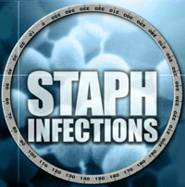
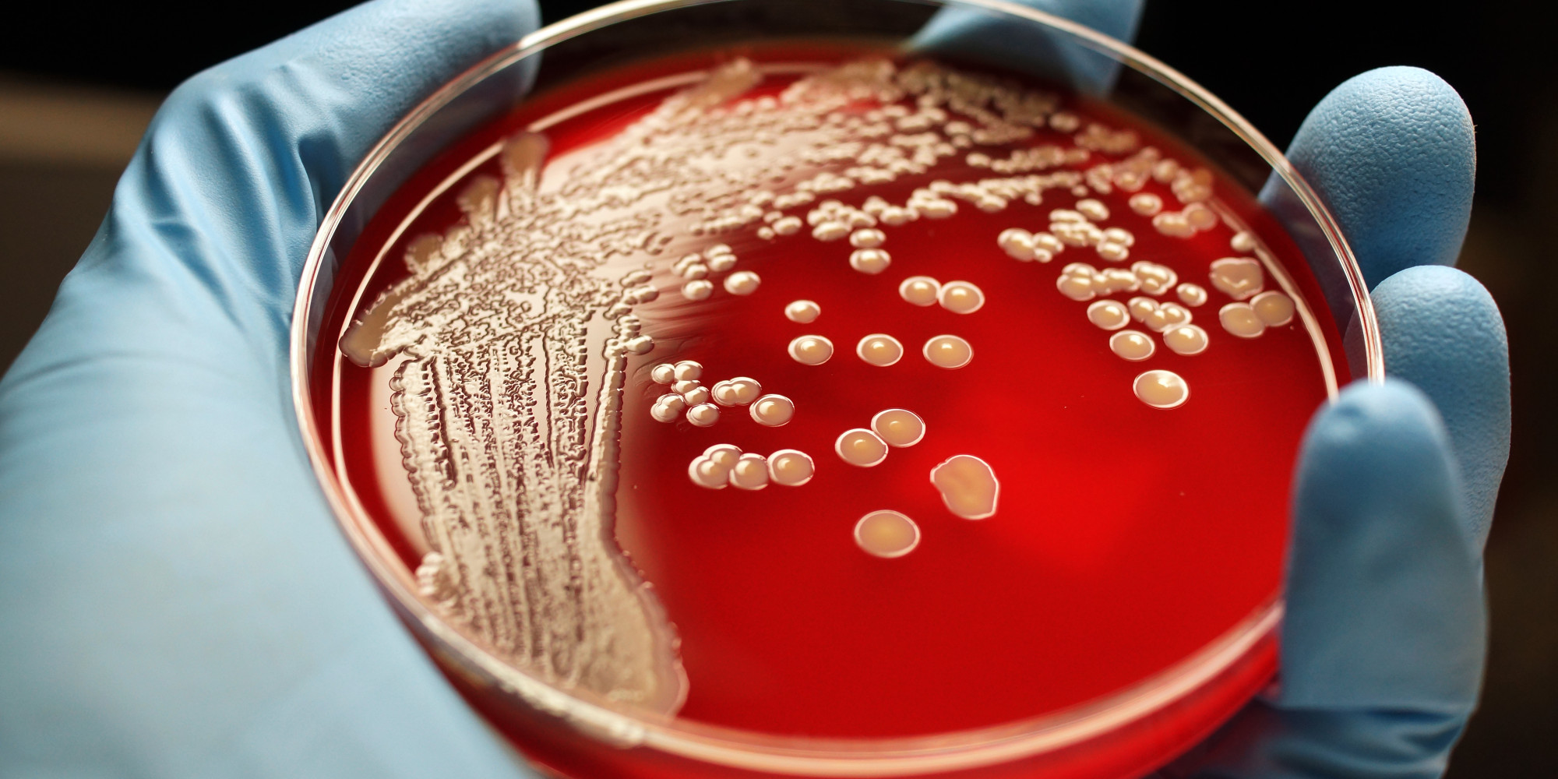
Skin and soft tissue
Surgicalwound
Bone/joint
Pneumonia
IV linesepsis
Bacteremia, endocarditis

Slide 8
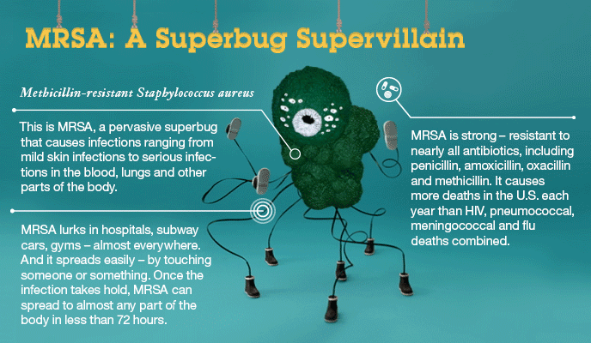
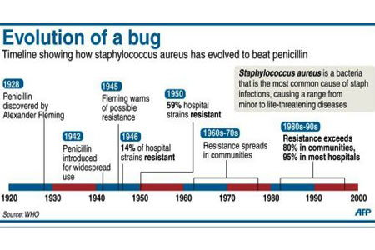

Slide 9
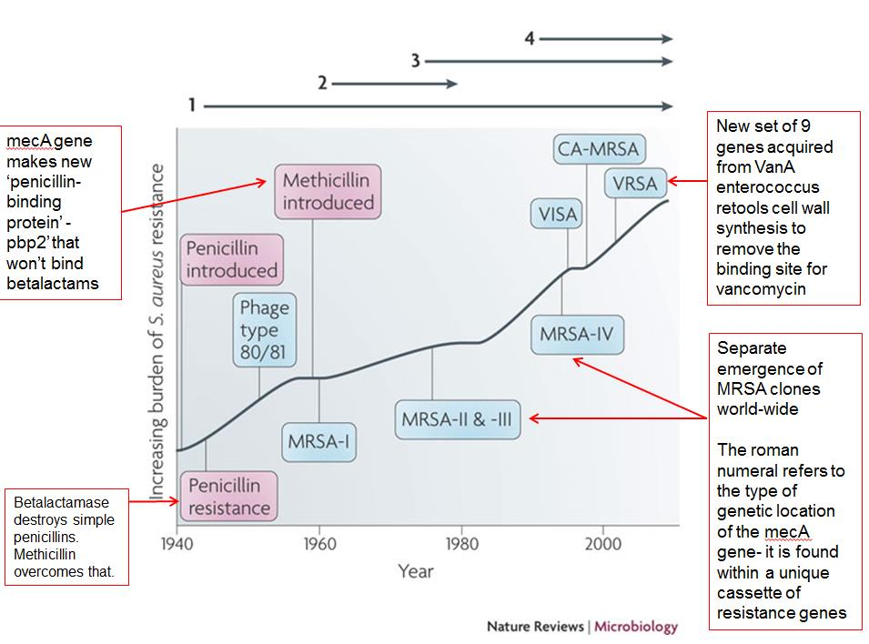

Slide 10
Colonization Infection
Asymptomatyc nasopharyngeal colonization
Community acquired lethal infections
Aggressive host-invasion;
Effective immune-evasion
Hospital acquired infections
Efficient spread;
MDR
Changes related to horizontal acquisition of genes. Modulation of gene expression, also in relation with the host.

Slide 11
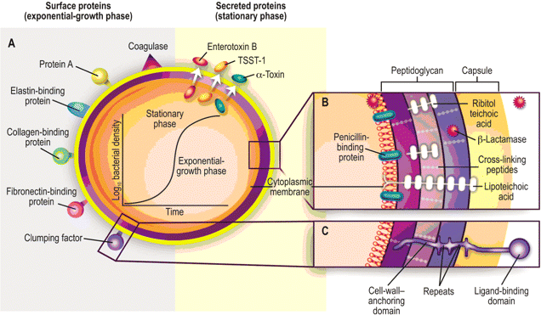
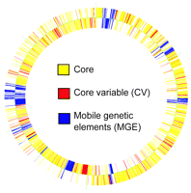
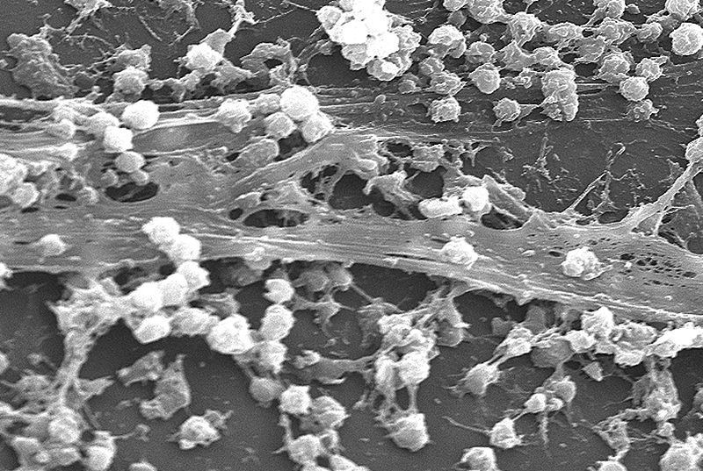
S.aureus Pathogenicity
(egc)
(spa)
(tst)
(cap5/cap8)
(hla)
(cna)
(fnbA)
(clfA/B)
Operone ica
(intercellular adhesin)
BIOFILM
icaR
icaA
icaD
icaB
icaC

Slide 12
S.aureus virulence determinants
Esotossine:
Esfoliatine (eta)
Enterotossine (sea,sec, sed, sej)
TSST-1 (tst)
IgG
Proteina A (spa)
Produzione di biofilm
Proteine di legame:
fibronectina (fnbA), collagenase (cna), fibrinogeno
Leucocidine (lukE, lukS/F)
Emolisine:
α-hemolysin (hla)
β –hemolysin (hlb)
γ-hemolysin (hlg)
δ-hemolisin (hld)
Invasine:
Clumping factor (clfA-B)
Coagulasi, Staphylokinase,
Hyaluronidase, Lipase
Protease (splB)
Adesine:
Autolisine (atl)
Adesine (sdrE, sdrC)

Slide 13
S.aureus
Changing epidemiology
MSSA
Less resistant
MRSA
HA-MRSA – hVISA / SCCmec I-XI
CA-MRSA –PVL+, SCCmec IV, V
More virulent strains

Slide 15
Role of surveillance

Slide 16
MRSA in Europe 2012-2015
2012
2013
2014
2015
Ireland | 1038 | 22,6 | (20-25) | 1069 | 19,9 | (18-22) | 1075 | 19,4 | (17-22) | 1057 | 18,1 | (16-21)
Croatia | 403 | 21,3 | (17-26) | 520 | 24,0 | (20-28) | 484 | 21,3 | (18-25) | 486 | 24,5 | (21-29)
Hungary | 1143 | 24,8 | (22-27) | 2012 1200 | 24,0 | (22-27) | 1279 | 23,1 | (21-25) | 1517 | 24,7 | (23-27)
Spain | 1899 | 24,2 | (22-26) | 1777 | 22,6 | (21-25) | 1920 | 22,1 | (20-24) | 1970 | 25,3 | (23-27)
Slovakia | 474 | 21,7 | (18-26) | 552 | 26,6 | (23-31) | 640 | 28,0 | (25-32) | 583 | 28,1 | (25-32)
Italy | 1636 | 35,2 | (33-38) | 2394 | 35,8 | (34-38) | 2134 | 33,6 | (32-36) | 3000 | 34,1 | (32-36)
Greece | 876 | 41,0 | (38-44) | 757 | 40,3 | (37-44) | 556 | 37,1 | (33-41) | 612 | 39,4 | (35-43)
Cyprus | 165 | 35,2 | (28-43) | 157 | 32,5 | (25-40) | 136 | 36,0 | (28-45) | 143 | 43,4 | (35-52)
Portugal | 1455 | 53,8 | (51-56) | 2390 | 46,8 | (45-49) | 3193 | 47,4 | (46-49) | 3619 | 46,8 | (45-48)
Malta | 102 | 47,1 | (37-57) | 114 | 51,8 | (42-61) | 82 | 42,7 | (32-54) | 89 | 48,3 | (38-59)
Romania | 229 | 53,3 | (47-60) | 383 | 64,5 | (59-69) | 316 | 56,0 | (50-62) | 297 | 57,2 | (51-63)

Slide 17
The Italian three-month surveillance study, 2012: numbers
Total isolates in the 52 (among 63) elegible Italian Institution | 21.873
S.aureus | 2541 11.6%
MRSA | 910 4.1% of all isolates
MSSA | 1631
MRSA/on S.aureus | 35.8%
Campanile F et al JGAR 2015

Slide 18
Activity of the main antimicrobials tested by automated methods against S.aureus isolates
MSSA (1044) | MIC (mg/L) |  |  | % R
 | Range | MIC₅₀ | MIC₉₀ | EUCAST
Oxacillin | ≤0.25 to >4 | ≤0.25 | 0.5 | 1.5
Cefoxitin | ≤2 | ≤2 | ≤2 | 0.0
Teicoplanin | ≤0.5 to ≥8 | ≤0.5 | ≤0.5 | 0.5
Vancomycin | 0.003 to 2 | 1 | 2 | 0.0
Daptomycin | ≤0.12 to 2 | 0.5 | 0.5 | 0.8
Linezolid | ≤0.12 to ≥8 | 2 | 2 | 0.25
Clindamycin | ≤0.25 to >8 | ≤0.25 | 0.5 | 2.0
Erythromycin | ≤0.25 to >8 | ≤0.25 | >8 | 15.5
Mupirocinª | ≤1 | ≤1 | ≤1 | 0.0
Gentamicin | ≤0.12 to >16 | ≤0.5 | 1 | 7.7
Moxifloxacin | ≤0.25 to ≥8 | ≤0.25 | 0.5 | 5.8
Levofloxacin | ≤0.12 to >8 | 0.25 | 1 | 7.2
Tetracycline | ≤0.5 to >16 | ≤0.5 | ≤0.5 | 3.7
TMP/SMX | ≤0.5 to ≥16 | ≤0.5 | ≤0.5 | 0.9
Rifampicin | ≤0.25 to >32 | ≤0.25 | ≤0.25 | 0.8
Tigecyclineª | ≤0.12 to 0.25 | ≤0.12 | ≤0.12 | 0.0
MRSA (640) | MIC (mg/L) |  |  | %R
 | Range | MIC₅₀ | MIC₉₀ | EUCAST
Teicoplanin | ≤0.5 to 8 | ≤0.5 | 1 | 0.9
Vancomycin | ≤0.25 to 2 | 1 | 2 | 0.0
Daptomycin | ≤0.12 to 2 | 0.5 | 1 | 3.2
Linezolid | ≤0.25 to ≥8 | 2 | 2 | 0.7
Clindamycin | ≤0.25 to ≥8 | ≤0.25 | ≥8 | 33.1
Erythromycin | ≤0.25 to ≥8 | ≥8 | ≥8 | 65.4
Mupirocinª | ≤1 to >8 | ≤1 | ≤1 | 0.0
Gentamicin | ≤0.25 to ≥16 | ≤0.25 | ≥16 | 39.5
Moxifloxacin | ≤0.25 to ≥8 | 4 | ≥8 | 72.3
Levofloxacin | ≤0.5 to ≥8 | ≥8 | ≥8 | 85.8
Tetracycline | ≤1 to ≥16 | ≤1 | ≥16 | 12.6
TMP/SMX | ≤0.5 to ≥16 | ≤0.5 | ≤0.5 | 3.2
Rifampicin | ≤0.25 to >32 | ≤0.25 | 4 | 16.4
Tigecyclineª | ≤0.12 to 1 | ≤0.12 | ≤0.12 | 0.9

Slide 19
Resistance complexity
Being naturally resistant or acquiring selected mechanisms is not the only way to become resistant
There is a dark side of resistance that take together the microrganism and the patho-physiology of an infection
Antibiotics act changing the microrganism in a way not only related to the antibiotic mechanism of action

Slide 20
Nathalie Q. Balaban, et al.
Bacterial Persistence as a Phenotypic Switch
Science 2004; 305: 1622-1625
ampicillin
culture
nanotechnology

Slide 21
Nathalie Q. Balaban, et al.
Bacterial Persistence as a Phenotypic Switch
Science 2004; 305: 1622-1625
ampicillin
nanotechnology

Slide 22
Nathalie Q. Balaban, et al.
Bacterial Persistence as a Phenotypic Switch
Science 2004; 305: 1622-1625
nanotechnology

Slide 23
chronic infection

Slide 24
Barberán J, et al. Conservative levofloxacin plus rifampicin treatment of staphylococcal prosthetic-joint infections.
Am J Med 2006; 119: 993-6
Months from
arthroplasty
cured/
treated
%
≤ 1
> 1
> 6
20 / 24
19 / 36
4 / 13
84
53
30
SURGERY
Mean duration of antibiotics: 6 months
Notes:
Cabe destacar que la tasa de fracaso en las PTR fue del 42.8% vs 28.1% en las PTC. Ademas la tasa de fracaso en los MRSA (levo S) fue muy superior a los MSSA (71 (5/7) vs 21 (3/14) %), si bien los MRSA tuvieron más duración de los sintomas y no hay multivariado.

Slide 25
“planktonic” bacteria
bactericidal antibiotic (5-10 d)
“adapted” bacteria
anti-biofilm antibiotic (2-6 m)
“persistent” bacteria
“suppresive” antibiotic (???)
acute infection
chronic
infection

Slide 26
Typing and molecular epidemiology

Slide 27
Figure 1. Worldwide prevalence of hospital-acquired MRSA
CC 5
CC 5
Japan
CC5 - CC8
CC22 – CC30
CC30
Korea
CC5
CC8
CC22
CC45
CC 8
CC 5 - CC8
CC30 - CC45
Taiwan
HK
Thailand
Vietnam
CC22
CC 5 - CC8
CC 5
Malta
Sri Lanka
Singapore
CC 5 – CC22
CC30
CC30
ST368-II
Modified from Grundmann H et al. Lancet 2006;368:874-85
Song JH, et al. ANSORP surveillance (2005-2006)
Stefani S et al IJAA 2014
unknown
< 1 %
1-5 %
5-10 %
10-25 %
25-50 %
> 50 %
Mejia C, et al. Braz J Infect Dis 2010;14 (Suppl 2):S79-S86.
Annual report of the EARS-Net. 2009-2013.
27
Notes:
27

Slide 28
Molecular epidemiology of MRSA VSSA and hVISA in Italy
Prevalence of the main MRSA clones among VSSA and hVISA strains
VSSA
E-MRSA15 ST22 - SCCmec IV.h | 37%
USA500 like ST8 - SCCmec IV.C | 23.5%
USA100 like ST5/105 - SCCmec II | 7.7%
Italian clone ST228 - SCCmec I | 4.5%
USA300 like ST8 - SCCmec IV.C | 3.8%
Brasilian Clone ST241 - SCCmec III | 2.3%
Sporadic: ST1-ST5-8-ST22- ST30-ST58- ST217-ST241-ST772 | 21.2%
hVISA
Italian clone ST228 - SCCmec I | 57%
USA100 like ST5/105 - SCCmec II | 16%
USA500 like ST8 - SCCmec IV.C/I | 13.5%
E-MRSA15 ST22 - SCCmec IV.h | 4.5%
Sporadic: ST5 - ST1446 | 9%
Campanile F et al – JGAR 2015

Slide 29
Screening

Slide 30
Screening of MRSA: is there any value?
Active surveillance cultures decrease MRSA incidence^{1,2}. (there are more than 100 studies, but they are often uncontrolled studies⁵)
No suggestion that universal screening was effective in reducing MRSA acquisition and infection^{3,4}.
1) Aldeyab MA et al – JAC 2008; 62: 593; Robicsek A et al – Ann Intern Med 2008; 148: 409; 3) Harbarth S. et al – JAMA 2008; 299; 1149; 4) Jeyaratnam D et al – Br Med J. 2008; 336: 927; 5) Wenzel R. et al- Inf Control Hosp Epidemiol 2009; 30: 499

Slide 31
MRSA surgical site infections
46 risk factors for MRSA SSIs in 670 patients with MRSA carriage were examined¹.
The probability of MRSA SSIs was 2-3 times greater among patients who had emergency surgery.
The majority of patients were free of MRSA on admission.
Of note in this study; MRSA carriage on admission and receipt of topical decolonization tretament were not correlated with MRSA SSIs.
Post-operative acquisition may play an important role in causing MRSA infections^{1,2}.
The best strategy for MRSA carriage in the surgery dept remains contorversial.
1) Harbarth S. et al Inf Control Hosp Epidemiol 2008; 29: 890; 2) San Juan R et al – J. thoracic Sur 2007; 134: 670

Slide 32
Antibiotic pressure
Many antibiotic classes are now ineffective against pandemic HA-MRSA, consequently antibiotic treatment can have different negative ecological effects:
Eradication of the susceptible skin flora including CoNS can increase the likelyhood of MRSA acquisition;
Antibiotics directly pre-select pre-existing MRSA in carriers enhancing the likelyhood of transmission;
Antibiotic selection pressure can transform low-level carriers to persistent high-spreaders of MRSA;
Antibiotics active against MSSA may convert MSSA carriers to non-carriers, indirectly promoting the spread of MRSA.

Slide 33
Antibiotic selection pressure and MRSA incidence
Only few intervention studies to decrease MRSA rate by active antibiotic policies have been published in the last 2 years¹. Their results were not univocal since several investigations did not observe an impact of antibiotic control measures on MRSA rates.
A Cochrane review published in 2005 did not present strong evidence to support MRSA control by antibiotic stewardship interventions².
1) Harbarth S. et al – JAC 2008; 62: 431-433; 2) Davey P. et al – Cochrane Database Syst Rev 2005; CD003543

Slide 34
ANTIBIOTIC PRESSURE and complexity

Slide 35
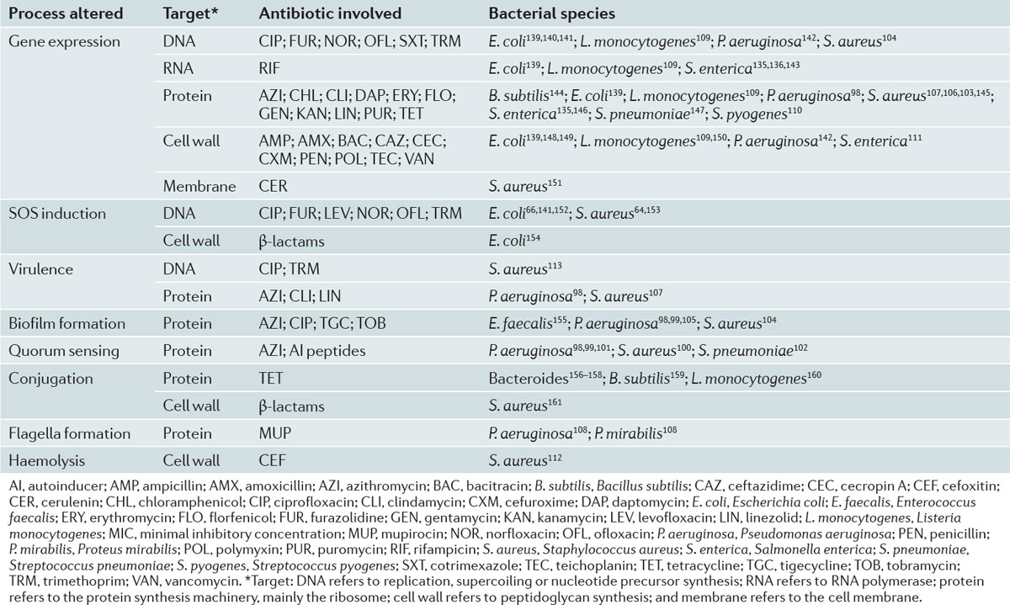
Andersson DI et al – Nat Rev Microbiol 2014; May

Slide 36
ANTIBIOTIC UNDERDOSAGE

Slide 37
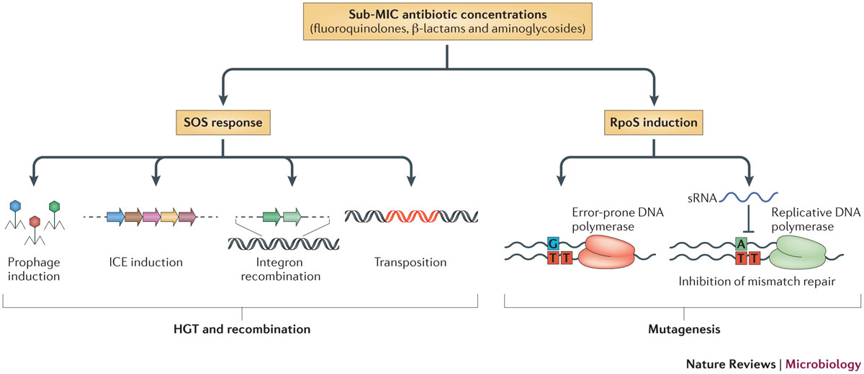
Abdersson DI et al – Nat Rev Microbiol May 2014

Slide 38
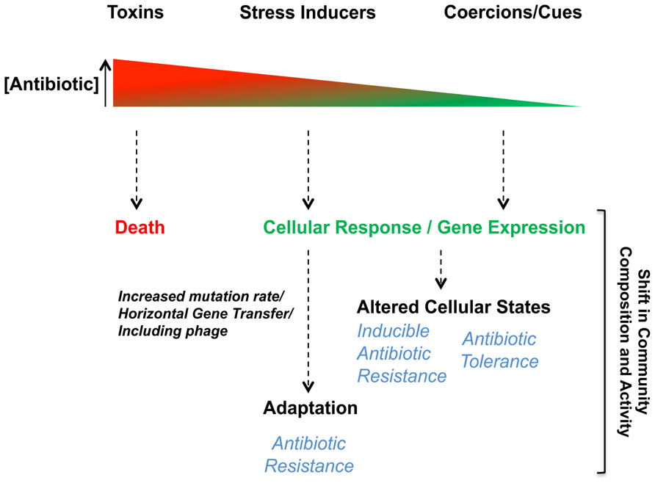

Slide 39
Azioni

Slide 40
i miei pensieri……
Riduzione dell’ impatto infezioni da germi MDR
Miglioramento della diagnostica (molecolare, rapida, point of care); stewardship diagnostica a partire dall’antibiogramma
Sorveglianze – internazionali, nazionali, regionali
Studi di prevalenza ripetuti
Report microbiologico –
Consumo degli antibiotici e politica di uso dell’antibiotico (stewardship)
Riconoscimento dei fattori di rischio e dei reparti a rischio
Le nuove entità delle infezioni MDR: RSA e anziani
CIO – individuazione problemi e intensificazione formazione personale sanitario
Sostegno e sviluppo di sistemi, modificare organizzazioni e comportamenti
Informazione cittadini e pazienti su MDR
Condividere esperienze già in atto in altre regioni/nazioni
Notes:
Quali procedure per ridurre la carica batterica
Quali procedure per l’isolamento del paziente
Quali procedure per la sterilizzazione
La riduzione del numero delle infezioni ospedaliere, comporta una salvaguardia del budget nella voce di rimborso per complicanze
Come favorire un ruolo del CIO più attivo e non di mera rendicontazione (valorizzazione degli impatti)

Slide 41
New perspectives
Rapid diagnostics and AST (pheno and molecular)
Metagenomic and resistome
NGS
Probiotics and LBPs
CRISP application such as microbiome engineered in order to enhance the human immune system beyond the fortitude of the wild-type, bacterial genome editing in medical aspects above all resistance

Slide 42
TAKE HOME MESSAGES….
MDR organisms need urgent global actions in all fields
Microbiologists, important part of the multidisciplinary team
Central role of the clinical lab for surveillance studies, detection of resistance and AST
R&D
New approaches for understanding how to face this phenomenon

