Slide 1
Superbugs
Strumenti di intervento nell’era post-antibiotica
“il punto di vista del farmacologo”
Gianni Sava
Antibiotico-Resistenza, Roma, 14 giugno 2017

Slide 2
“One can think of the middle of the twentieth century as the end of one of the most important social revolutions in history, the virtual elimination of the infectious diseases (AD 1962)”
Sir Frank MacFarlane Burnet
Nobel Prize for Medicine in 1960

Slide 3
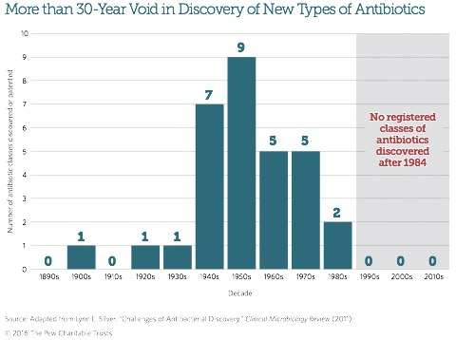
2/10

Slide 4
Open aspects and problems
Too few novel antibiotics coming to market to replace those lost due to resistance development
Antibiotic innovation in academia is not filling the void due to misaligned incentive structures and lack of vital knowledge of drug discovery
Targeting an organism inside another organism’ have not been given enough attention
The Lipinski rule of 5
3/10

Slide 5
4/10

Slide 6
5/10

Slide 7
6/10

Slide 8
Widespread antimicrobial use has compromised its value,
leading to a crisis of antimicrobial resistance. A major
cause of misuse is insufficient knowledge of prescribing of antimicrobials in many categories of professionals.
It is now crucial that academia and ministries of Health and Education jointly focus on an adapted undergraduate medical/professional curriculum that teaches all necessary principles of microbiology, infectious diseases and clinical pharmacology, with emphasis on the principles of prudent prescribing.
7/10

Slide 9
8/10

Slide 10
Antibiotic stewardship education for health care providers gives a foundation of knowledge and an environment that facilitates and supports optimal antibiotic prescribing.
There is a need to extend this education to medical students and health care trainees. Education using passive techniques is modestly effective for increasing prescriber knowledge, whereas education using active techniques is more effective for changing prescribing behavior. Such education has been shown to enhance other antibiotic stewardship interventions.
9/10

Slide 11
by Rovina Ruslami, *Dick Menzies
After the widespread introduction of rifampicin in the early 1970s, it took another two decades, and more than 50 randomised trials with more than 20,000 participants to finalise the drugs, doses, and schedule for the currently recommended regimen for newly diagnosed patients with active tuberculosis. Yet this regimen has important drawbacks, most notably the 6 months duration, and frequent toxicity.
www.thelancet.com/infection Vol 17 January 2017
10/10

Slide 12
Molecules 2016, 21, 836
I/V

Slide 13
Molecules 2016, 21, 836
II/V

Slide 14
III/V

Slide 15
IV/V

Slide 16
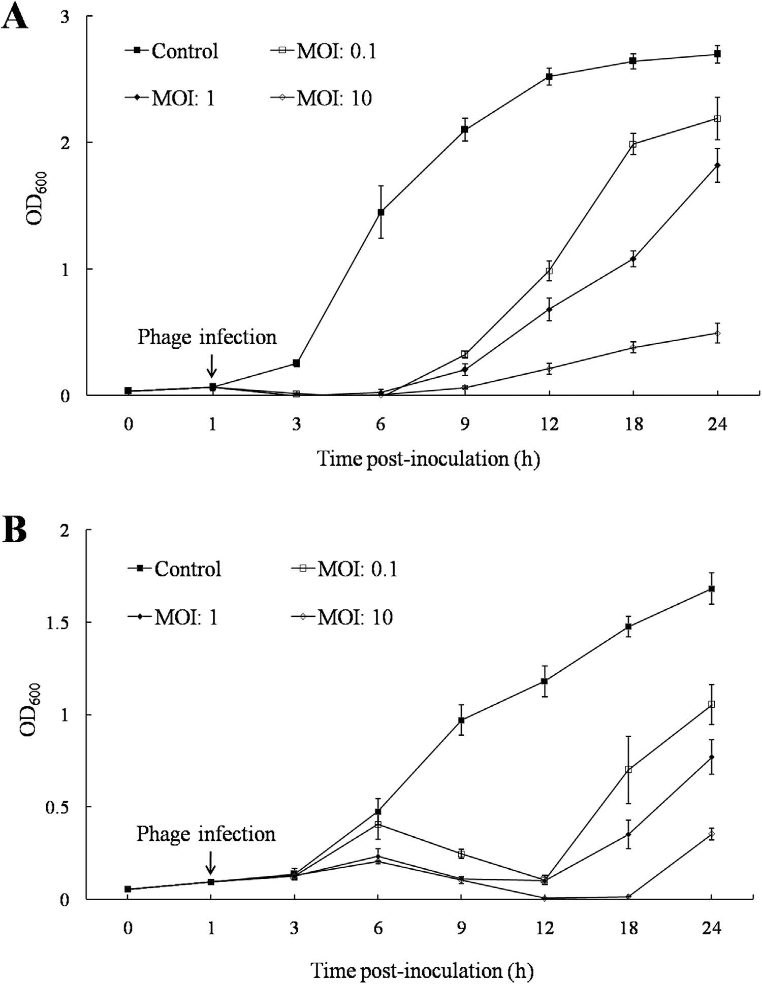
Bacteriophage application to control the contaminated water with Shigella
Scientific Reports | 6:22636 | DOI: 10.1038/srep22636
V/V
Notes:
Time course of host cell lysis effect of pSs-1 against S. sonnei ATCC® 25931 (A) and S. flexneri
ATCC® 29903 (B). Early exponential phase cultures of S. sonnei ATCC. 25931 and S. flexneri ATCC. 29903
were co-cultured with pSs-1 at MOIs of 0, 0.1, 1, and 10.

